Slide 1

Data Science Mini Project
Credit Card Data

Slide 2
PROBLEM STATEMENT
Overview: This case requires trainees to develop a customer segmentation to define marketing strategy. The sample dataset summarizes the usage behavior of about 9000 active credit card holders during the last 12 months. The file is at a customer level with 18 behavioral variables.

Slide 3
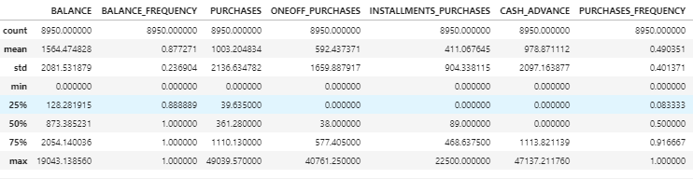
Dataset Understanding
The dataset contains approximately 9000 entries of customers with 18 behavioral variables.
It summarizes the usage behavior of active credit card holders during the last 12 months.

Slide 4
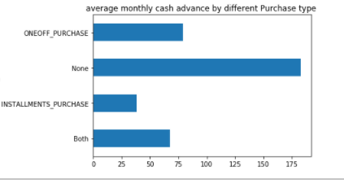
Insights using Derived KPI’s
Customers which take installment purchases have least monthly cash advance
Customers who don't take either one-off or installments take most cash advance.

Slide 5
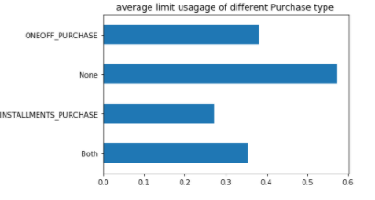
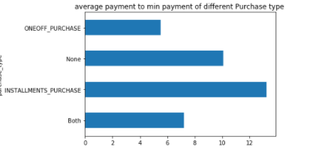
customers which take installment purchases
have least limit usage
customers who don't take either one-off or installments have greater limit usage.
customers paying installments have greater payment to min payment ratio

Slide 6
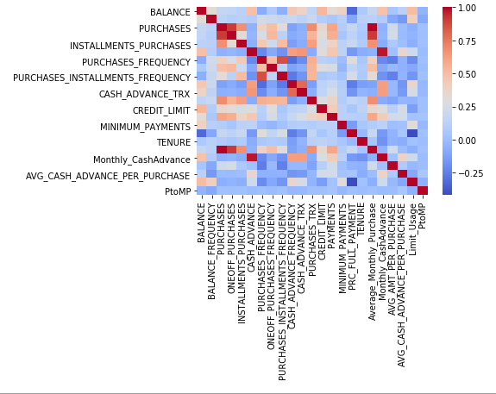
Identification of the relationships services
Purchases are highly positively correlated to credit limit and payments
Balance is highly positively correlated to payments, credit limit, cash advance but highly negatively correlated to % of months with full payment of due balance
Purchase frequency is highly negatively correlated to cash advance frequency
Installment frequency is also negatively correlated to cash advance frequency
Credit limit is almost positively correlated with everything

Slide 7
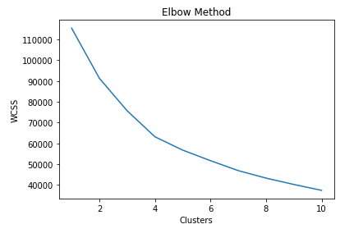
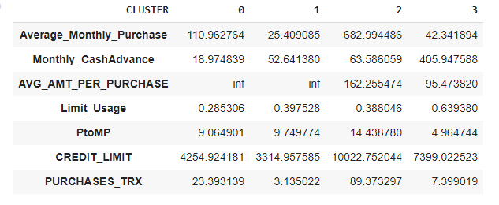
CLUSTERING
Optimal k from the elbow method came out to be 4. Therefore 4 clusters were formed.

Slide 8
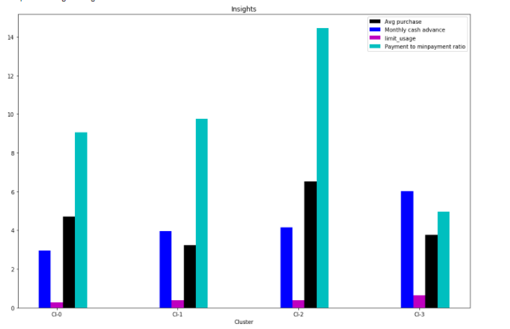

Slide 9
Insights and Statergies
Cluster 2
Cluster 2 has most purchases and also has highest payment to minimum payment ratio. They also have a decent limit usage. Thus can be termed as loyal customers and needs to be retained. This cluster can be targeted by introducing loyalty programs or by awarding cashbacks for each transaction to promote more purchases.
Cluster 0
Cluster 0 has the lowest limit usage. Thus to target this section we can provide more credit limit to this section with lower interest.
Cluster 3
Cluster 3 has the highest monthly cash advance and also high limit usage. These are not the best type of customers a company would want. But to target this section offering lower interest rate can be an option.

Slide 10
Cluster 1
Cluster 1 has lowest average purchases but decent limit usage and a good payment to min payment ratio. This cluster is around 45% of whole user base. To promote transaction rewards and cashbacks should be introduced.
GOOGLE COLLAB LINK:
https://colab.research.google.com/drive/1bgJCWiWOhKpRh9Mq6H5m4FzoeV7g0Ww?usp=sharing

